Slide 1
CodeU
Bootcamp
Welcome to your 6th & 7th session!
The class will start shortly...
Reproduction and distribution of the presentation deck is prohibited

Slide 2
Agenda for today’s class
Recap of last class
01
02
Material
Revision
To refresh our minds!
Let’s see what we’ve covered throughout the Bootcamp!
Topic of the day:
03
04
Time to code!
Team up and tackle the problem!
CodeU Tournament: Ice Cream Store
Wrap-up
Conclusion
05
06
CodeU Robot
Summary of what we’ve learned today
Ask your questions!

Slide 3








Build an
Ice Cream
Store

Slide 4

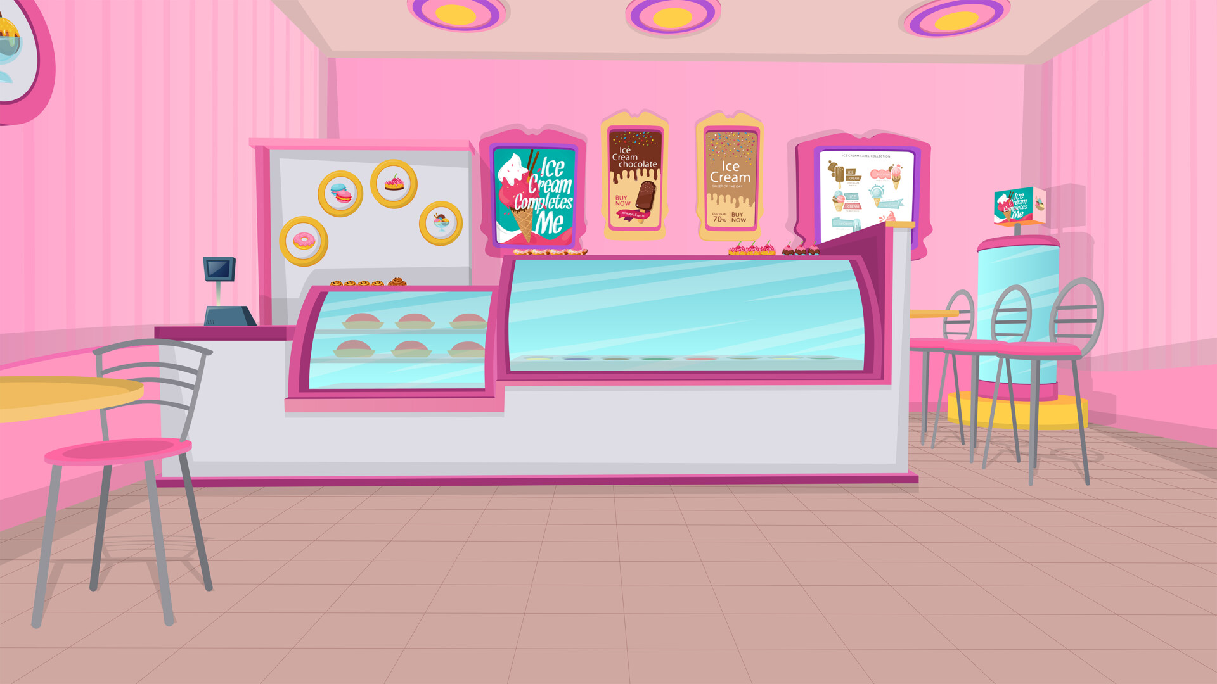
Tournament Details
Goal
Each team (Teams of 2-3) must successfully create an ordering system where customers can pick a cone size and an ice-cream flavor, and the total price will be given to them.
Step-by-Step
Step 1
Step 2
Step 3
Step 4
Customer is greeted
Customer selects flavor
Customer selects cone size
Print the total price

Slide 5
Ice Cream Store Menu
Small
2.00$
Vanilla
Chocolate
3.00$
Medium
5.00$
Vanilla
Chocolate
7.00$
Large
12.00$
Vanilla
Chocolate
18.00$

Slide 6
Build your code!
01
Greet your customer to your store! Give your store a name☺
02
Create an input variable named icecream that asks the customer for their ice cream flavor.
03
Create your first layer of conditionals for the ice cream flavor(Example: if icecream == ’’vanilla’’:)
04
Create an input variable names conesize that asks the customer for their cone size.

Slide 7
Build your code!
05
Create your second layer of conditionals for the conesize (Example: if conesize == ’’small’’:)
06
Let the user know the cost of their order! Refer to the menu for prices.

Slide 8
Congratulations coders!
Congratulations on completing 2 awesome months with CodeU! We hope you had a great bootcamp ☺

Slide 9




Thank you!
Does anyone have any questions?
This was our last class for Chapter 1 of the Bootcamp! You are now on your way to becoming an independent coder ☺
Phone:
(438) 391-9106
Email:
hello@codeu.ca

